Slide 1
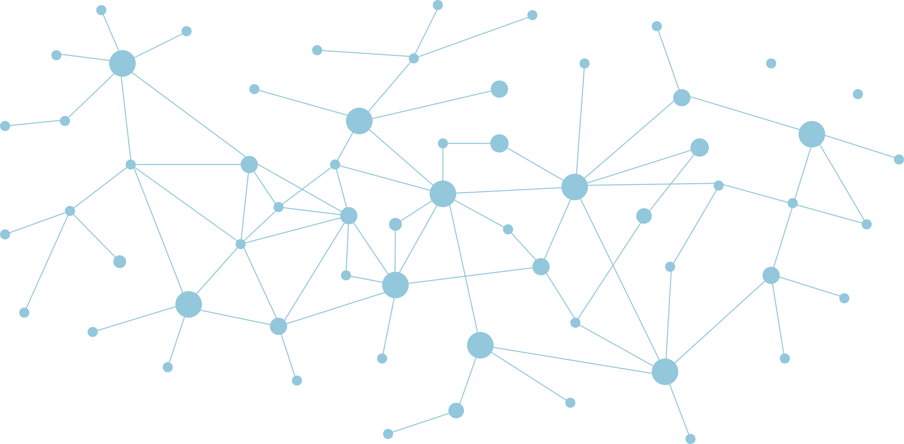
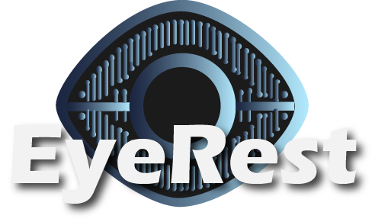

Unlock your potential with every blink.
- Team Innovators

Slide 2

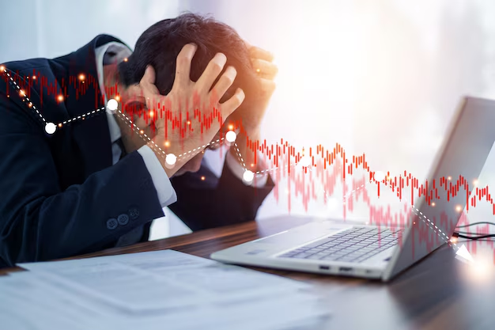


Problem
Workplace burnout is escalating in Saudi Arabia, affecting 57% of employees. Excessive workloads and stress weaken productivity, morale, and performance.
Decreased Productivity
Increased Absenteeism
High turnover costs
Burnout impairs focus and decision-making, costing companies over $500B in annual losses.
Burnout increases sick leaves, disrupts workflows and lowers morale.
46% of HR leaders say burnout drives up to half of workforce turnover.

Slide 3
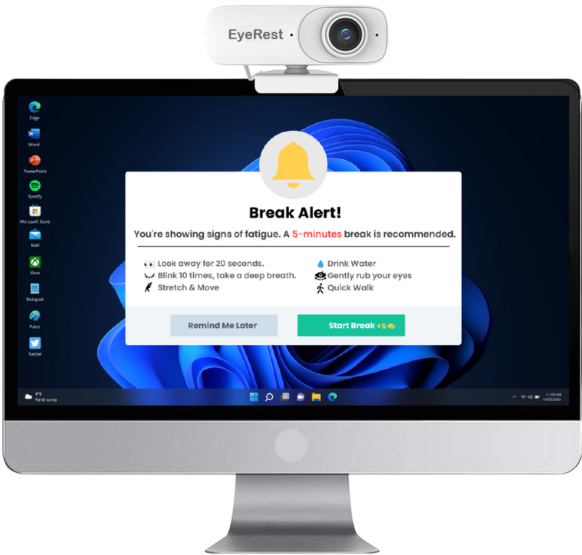
Solution
EyeRest uses AI-powered eye tracking to detect early burnout signs through eye movements. It then delivers real-time, personalized interventions to help employees recharge and stay productive.
Analysis : Continuously monitors blink rate, gaze stability, and pupil dilation to detect early burnout signs.
Interventions : Suggests customized breaks and focus-activities based on detected burnout levels.
Gamified Rewards : Encourages break adherence with redeemable points.
Supervisor Dashboard : Tracks burnout indicators and break compliance, ensuring a healthy work balance.
Privacy : Uses real-time data processing with no storage; requires explicit consent.

Slide 4
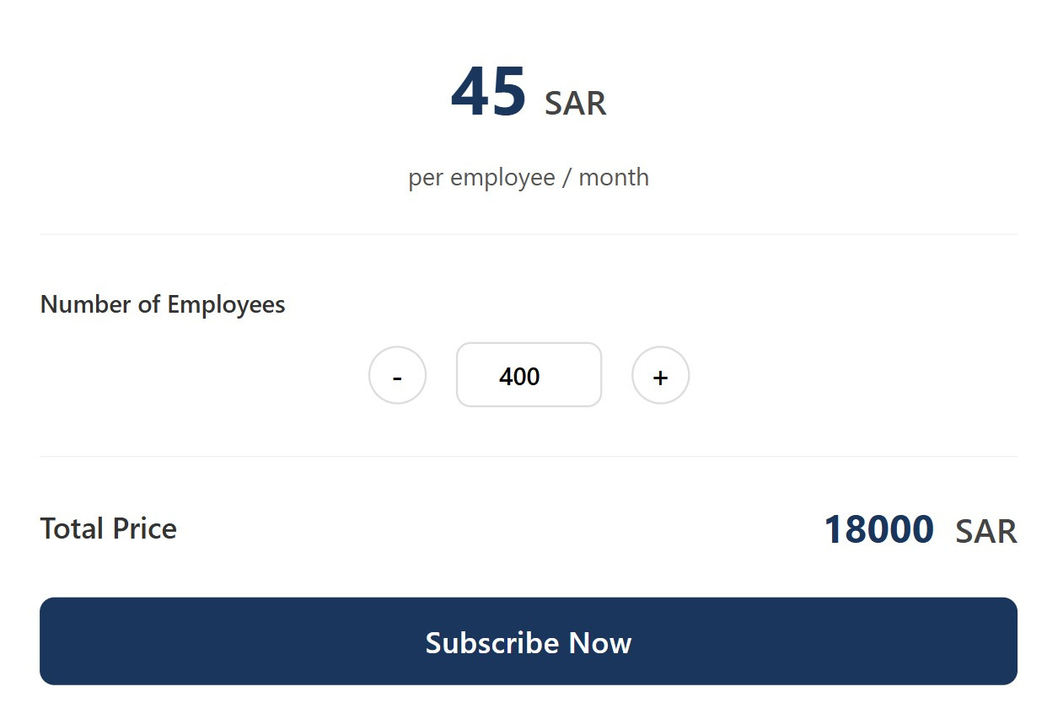
01
We estimate an initial investment of 50k–70k SAR for technology development, marketing, and product validation.
Business Model
02
Our revenue comes from strategic partnerships and recurring subscriptions.
03
Competitive pricing at 40–50 SAR per employee each month, potentially generating 100k–600k SAR in annual revenue per partnership, depending on company size.
04
We focus on tech and finance companies with high screen time, long hours, and high pressure.
05
In the long term, we aim to secure strategic partnerships with industry giants such as Google, Microsoft, Amazon, PwC, and KPMG.

Slide 5




Technology & Value
How EyeRest?
Why EyeRest?
Eye-Tracking: Monitors blink rate, gaze patterns, and pupil dilation to detect early signs of burnout.
AI & ML: Processes large data sets to predict burnout risk and recommend targeted interventions.
Real-Time Analysis: Delivers immediate insights and alerts without storing personal information.
Data Visualization: Offers clear dashboards for supervisors to track and manage employees’ burnout levels.
Scientifically Supported: Research shows ocular metrics correlate with fatigue and stress, which drive burnout.
Proactive Prevention: Early detection and alerts help address issues before they escalate.
Supervisor Dashboard Insights: Supports informed decision-making and balanced workload distribution to enhance productivity.
Enhanced Well-Being & Productivity: Prioritizing employee mental health boosts performance and retention, creating a win-win for both employees and the organization

Slide 6


Competition
Feature | Aramco Fatigue Management Systems | Takalam | Smart Eye | EyeRest
Privacy and Security
Personalized Interventions
Eye Tracking Technology
Real-Time Burnout Detection
Saudi Arabia
UAE
Sweden

Slide 7
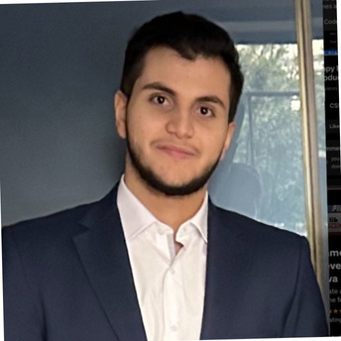



Team Members
Team Leader
Ahmed Yasser
Mustafa Mallesho
“As an award-winning public speaker and experienced hackathon leader, I foster a collaborative, comfortable team environment. I am eager to lead our team to success!
“As a software engineering student with diverse project experience, I transform EyeRest from an innovative idea into an impactful solution.”
Hazem Al-Hatim
“Focused on AI and machine learning, I excel in data extraction and model building to ensure EyeRest outperforms competitors.”
Yara Ahmed
Nadia Sibai
“With a passion for digital media and graphic design, I enhance EyeRest’s interface for a seamless, visually engaging experience”.
“Leveraging a strong background in business intelligence and multiple hackathon experiences, I build robust, strategic business plans for EyeRest.”

Slide 8
Future Opportunities
Industry-Specific Customization
ensuring solutions meet sector-specific needs
Soft Launch
Global Expansion
September 2025
February 2026
September 2026
Starting Development
Corporate wellness partnerships
Enhanced detection
working with HR platforms, wellness programs, and occupational health providers.
Include more indicators in detecting fatigue, such as typing speed/accuracy
May 2025
November 2025
June 2026

